Slide 1
Project One
King’s County Housing Data

Slide 2
OSEMN Method
Obtain
Scrub
Explore
Model
Interpret

Slide 3
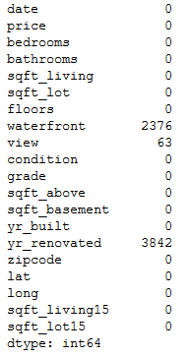
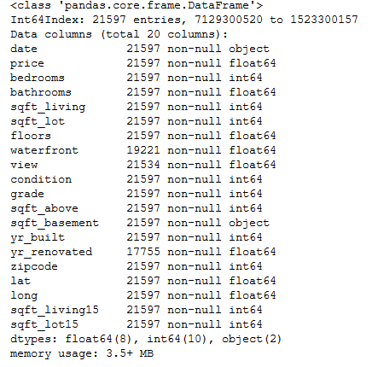
Scrub
Replaced NAN values and place holders with the median value

Slide 4
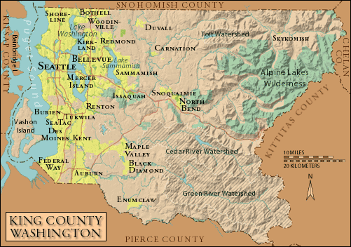
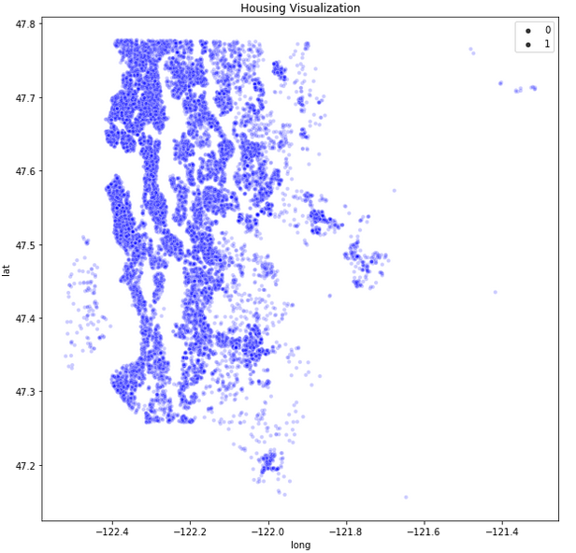
Explore

Slide 5
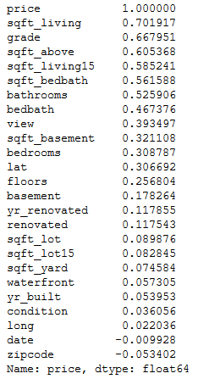
Explore Cont.
Highly Correlated variables to price:
sqft
Grade
Bathrooms
Bed & bath combined

Slide 6
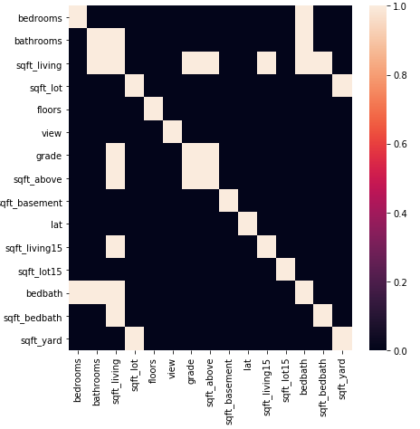
Multicollinearity
The features with a high correlation with each other greater than 0.75.

Slide 7
Feature Selection/Engineering
Combined sqft_living and grade to form sqft_grade which shows the points assigned per sqft.

Slide 8
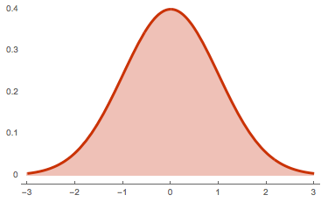
Scaling and Standardization
Features were scaled to prevent higher valued features such as sqft_living from overtaking sqft_grade.
Features were normalized to closely represent a normal distribution

Slide 9
Modeling
Features Used:
Sqft_lot
Sqft_above
Sqft_basement
Lat
Floors
Viiew
Formed train/test splits for model testing using 20% as training data

Slide 10
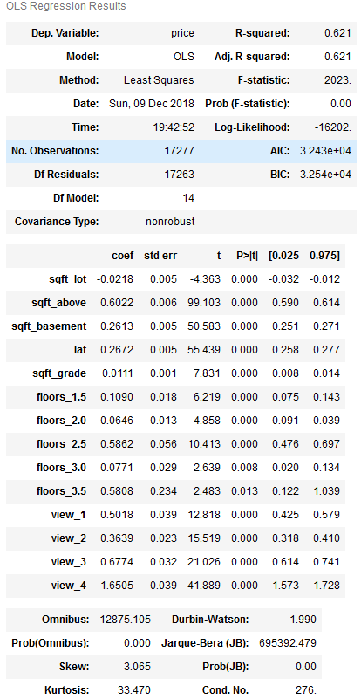
OLS Model

Slide 11
OLS Models Cont.
Model 1 67.09: sqft_lot, sqft_above, sqft_basement, lat, floors, view
Model 2 62.45: sqft_lot, sqft_above, sqft_basement, lat, sqft_grade
Model 3 56.39: sqft_lot, sqft_above, sqft_basement, lat
Model 4 46.72: sqft_lot, sqft_above, sqft_casement, lat

Slide 12
Conclusion
The model that gave the best score was model 1 with a score of 67.05 with the following features
Sqft_lot
Sqft_above
Sqft_basement
Lat
Sqft_grade
Floors
View

